Slide 1
Mouse thyroid tissue
Gene Expression analysis
Pink1 Knock-out

Slide 2
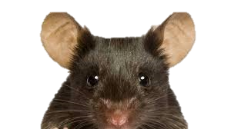
Tissue prep.
24-month B6 mouse thyroid tissue
- Pink1 K/O : 5ea
Sample ID: P2, P4, P6, P8, P9
- WT : 5ea
Sample ID: W5, W6, W7, W8, W9
RNA seq.
(illumina)

Slide 3
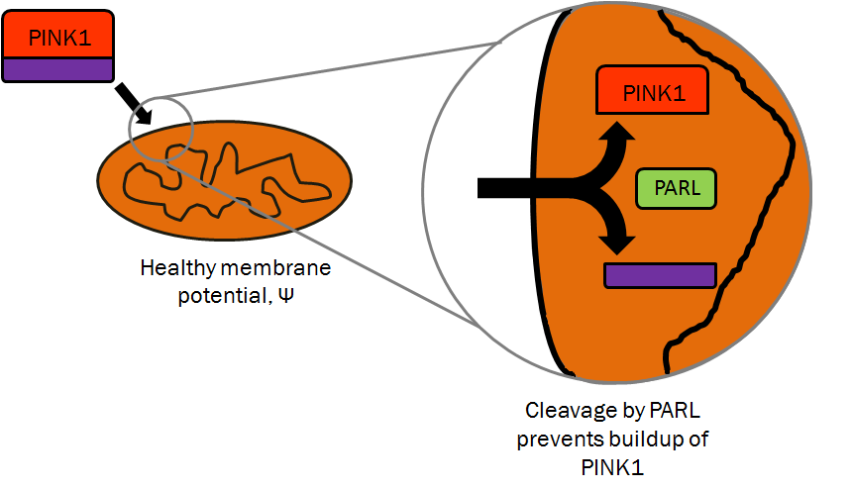
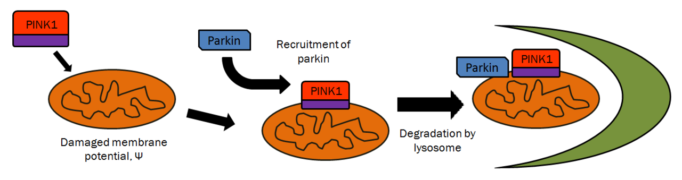
PINK1 – PTEN induced putative kinase 1
1. healthy
2. Damaged

Slide 4
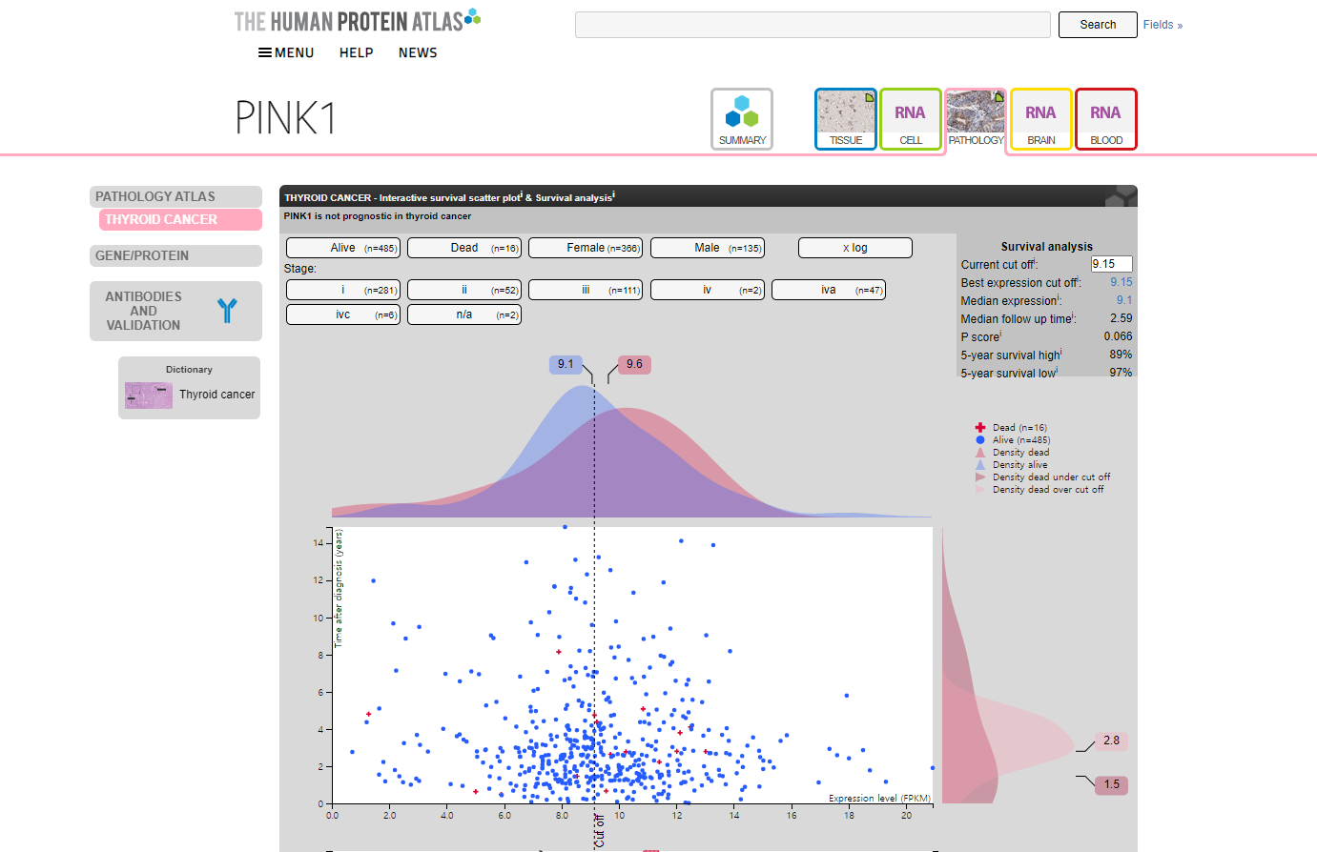
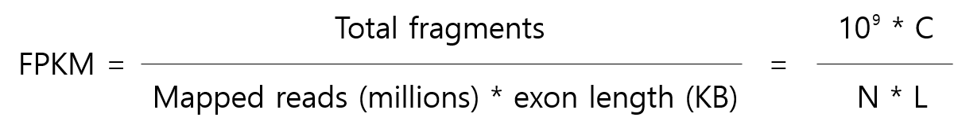
PINK1 – Expression in thyroid cancer

Slide 5
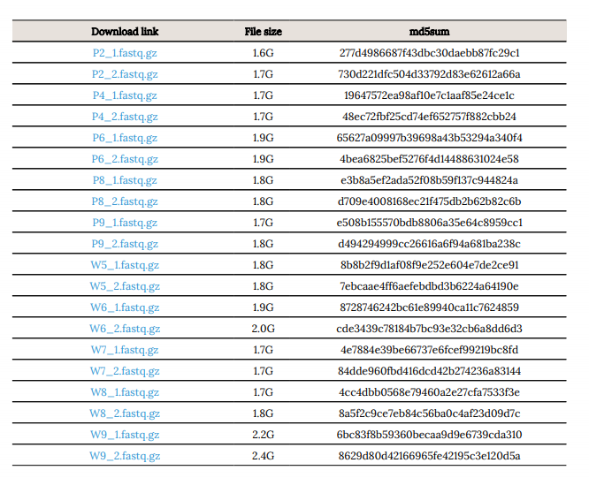
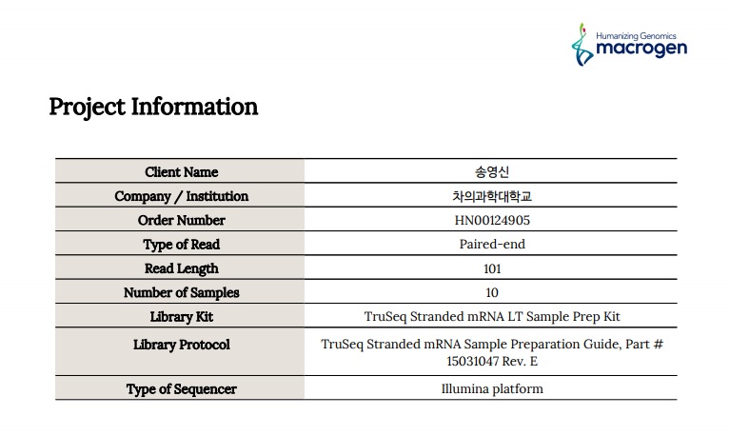
RNA sequencing - information

Slide 6
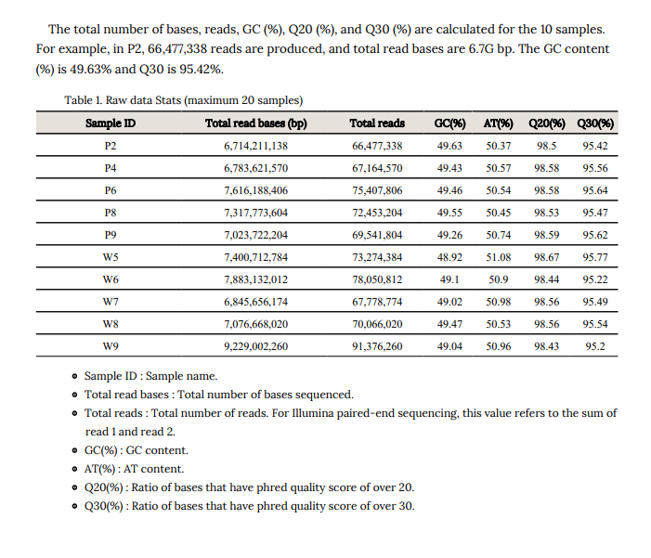
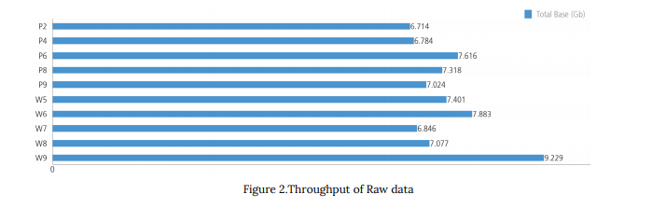
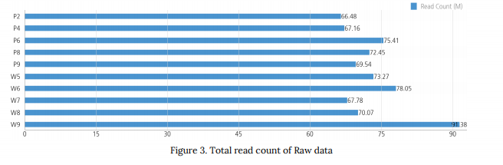
RNA sequencing – summary of data
Summary of data
Total read bases
Total reads

Slide 7
Analysis pipeline
QC
Alignment
Expression call
DEG
(Differentillay expressed gene)
Pathway
(Gene ontology)
FastQC
Trimmomatic
SortmeRNA
STAR
RseqC
HTseq
DEseq
Plotting - ggplot (Volcano, Heatmap…etc)

Slide 8
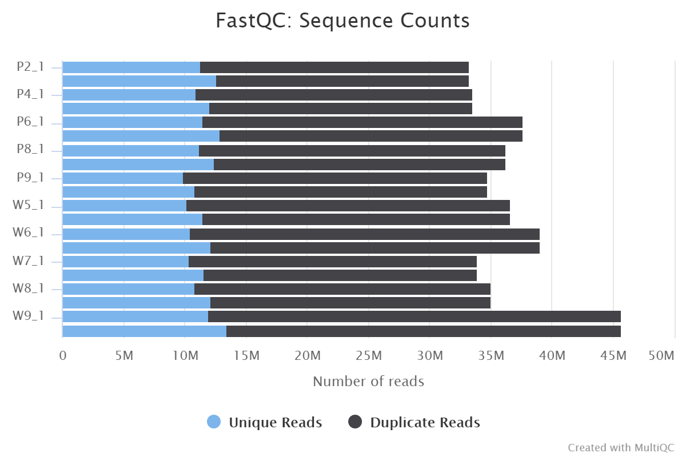
Quality control – MultiQC
General Statistics
Sample Name | % Dups | % GC | M Seqs
P2_1 | 66.0% | 49% | 33.2
P2_2 | 61.9% | 49% | 33.2
P4_1 | 67.4% | 49% | 33.6
P4_2 | 64.1% | 49% | 33.6
P6_1 | 69.6% | 49% | 37.7
P6_2 | 65.9% | 49% | 37.7
P8_1 | 69.0% | 49% | 36.2
P8_2 | 65.8% | 49% | 36.2
P9_1 | 71.5% | 49% | 34.8
P9_2 | 68.8% | 49% | 34.8
W5_1 | 72.1% | 48% | 36.6
W5_2 | 68.7% | 49% | 36.6
W6_1 | 73.1% | 48% | 39.0
W6_2 | 68.8% | 49% | 39.0
W7_1 | 69.5% | 48% | 33.9
W7_2 | 65.9% | 49% | 33.9
W8_1 | 69.0% | 49% | 35.0
W8_2 | 65.2% | 49% | 35.0
W9_1 | 73.8% | 48% | 45.7
W9_2 | 70.5% | 49% | 45.7

Slide 9
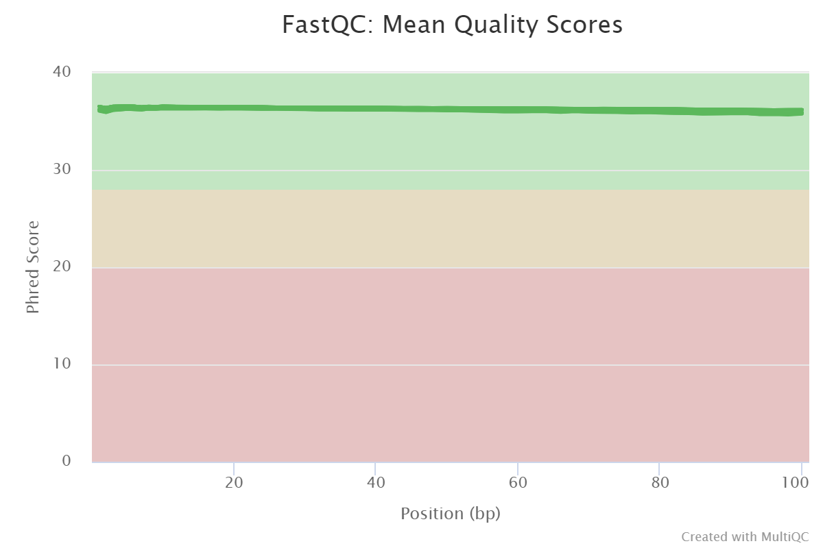
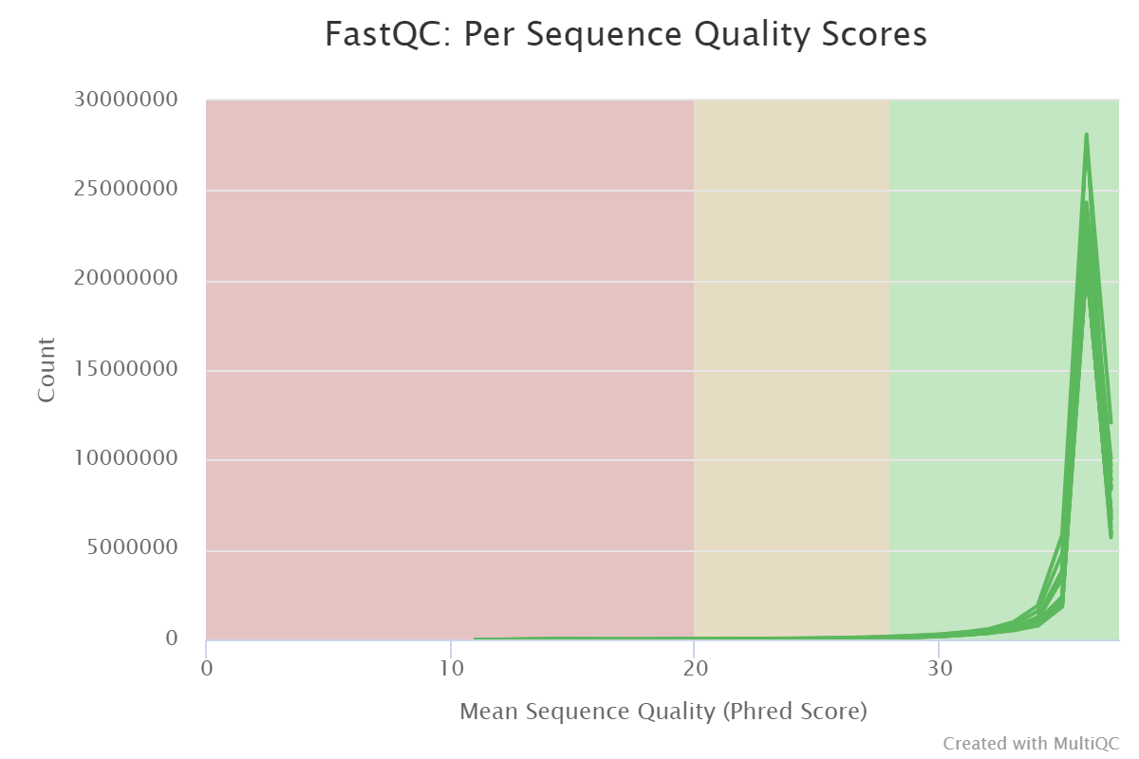
Quality control – MultiQC
Sequence Quality Histograms
Per Sequence Quality Scores
20 / 20 samples passed
20 / 20 samples passed

Slide 10

Quality control – MultiQC
Per Base Sequence Content ( Heatmap )
20 / 10 samples failed
20 / 10 samples with warning

Slide 11
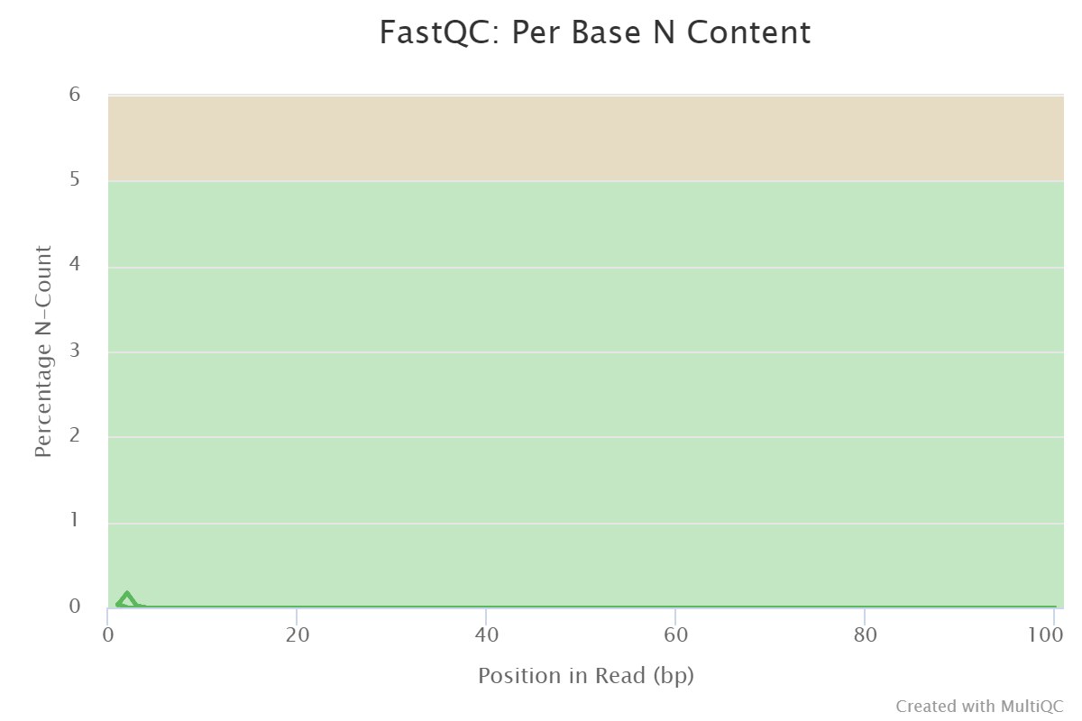
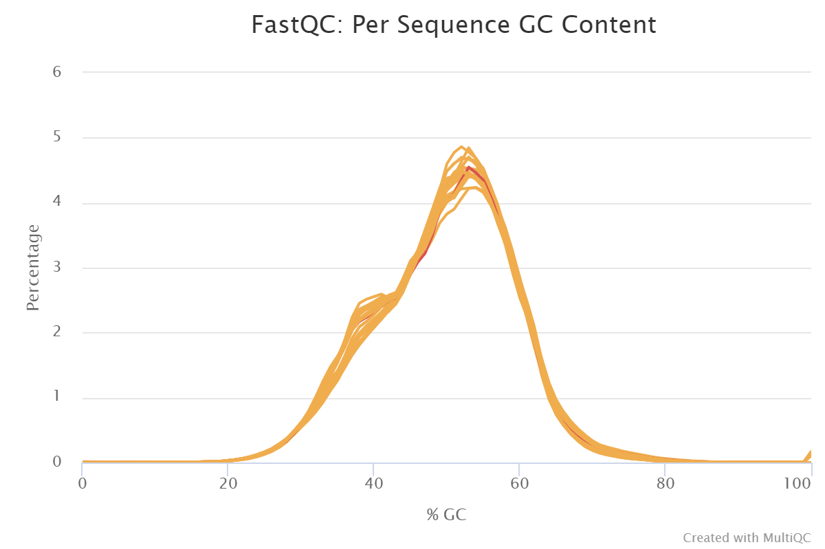
Quality control – MultiQC
20 / 1 samples failed : W6_2
20 / 20 samples passed
20 / 19 samples with warning

Slide 12
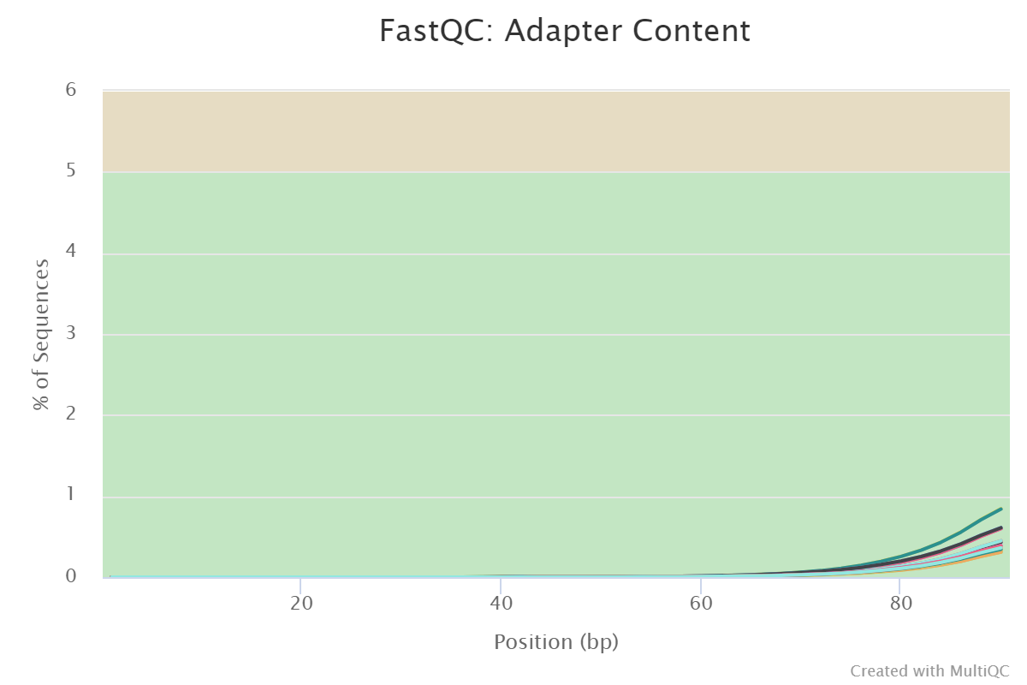
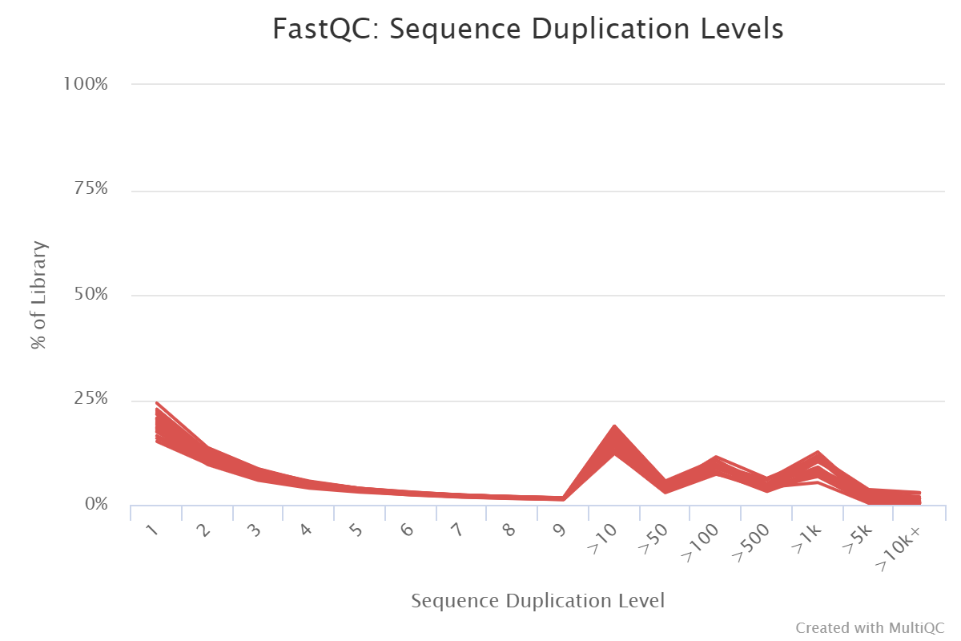
Quality control – MultiQC
20 / 20 samples failed
20 / 20 samples passed

Slide 13
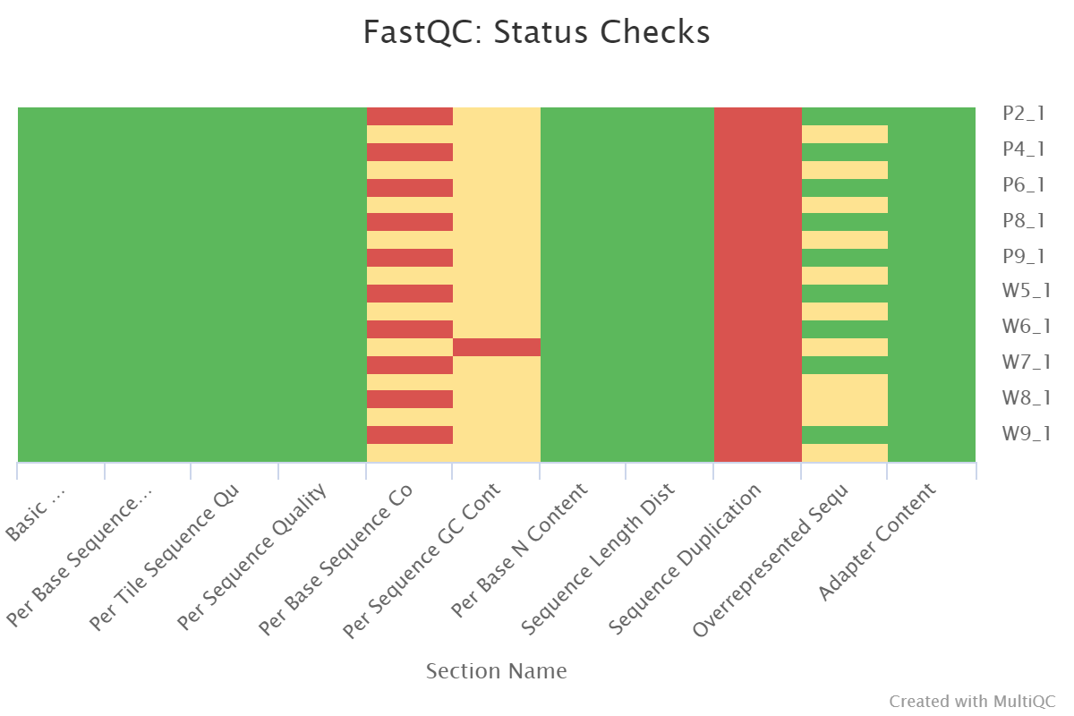
Quality control – MultiQC (Summary)

Slide 14
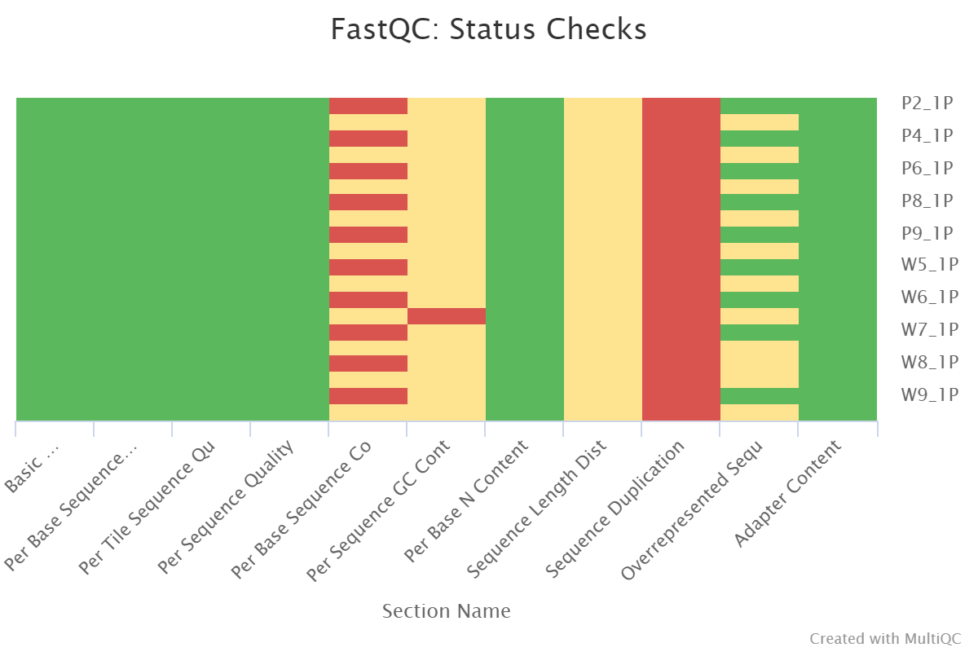
Quality control – after trimming
No samples found with any adapter contamination > 0.1%

Slide 15
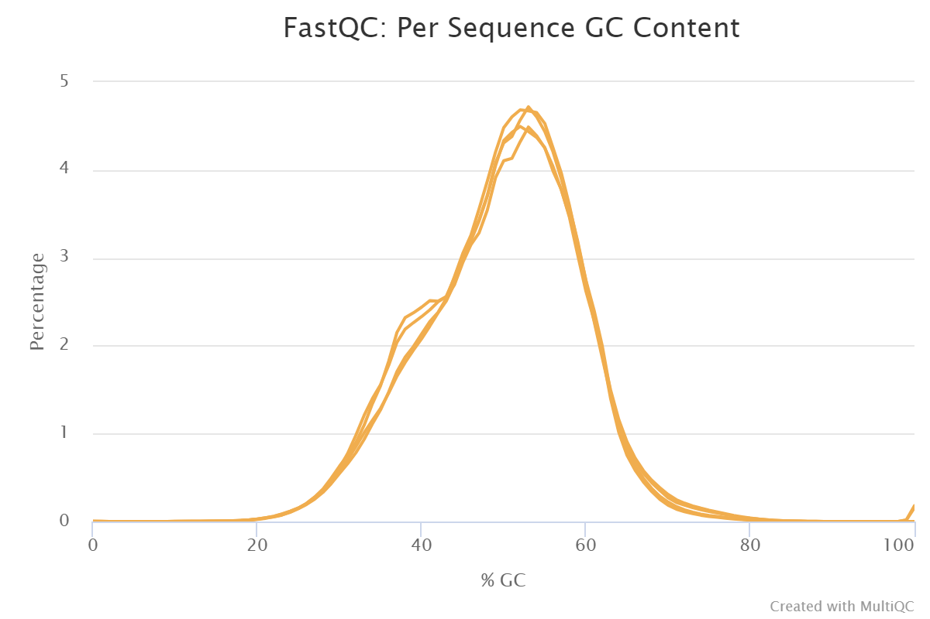
Quality control – SortmeRNA

Slide 16
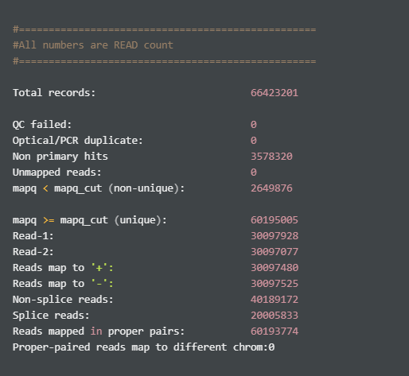
Alignment – STAR, RseqC
Total records: 전체 mapping 된 read 개수
QC failed: QC 에서 품질이 낮아 걸러진 read 개수
Non primary hits: best hit 이 아닌 다른 alignment 의 개수
Unmapped reads: mapping 이 되지 않은 read 개수
mapq < mapq_cut (non-unique): mapping quality 가 기준 미만으로, unique 하다고 볼 수 없는 read 개수
mapq >= mapq_cut (unique): mapping quality 가 기준 이상으로, unique 하다고 볼 수 있는 read 개수

Slide 17
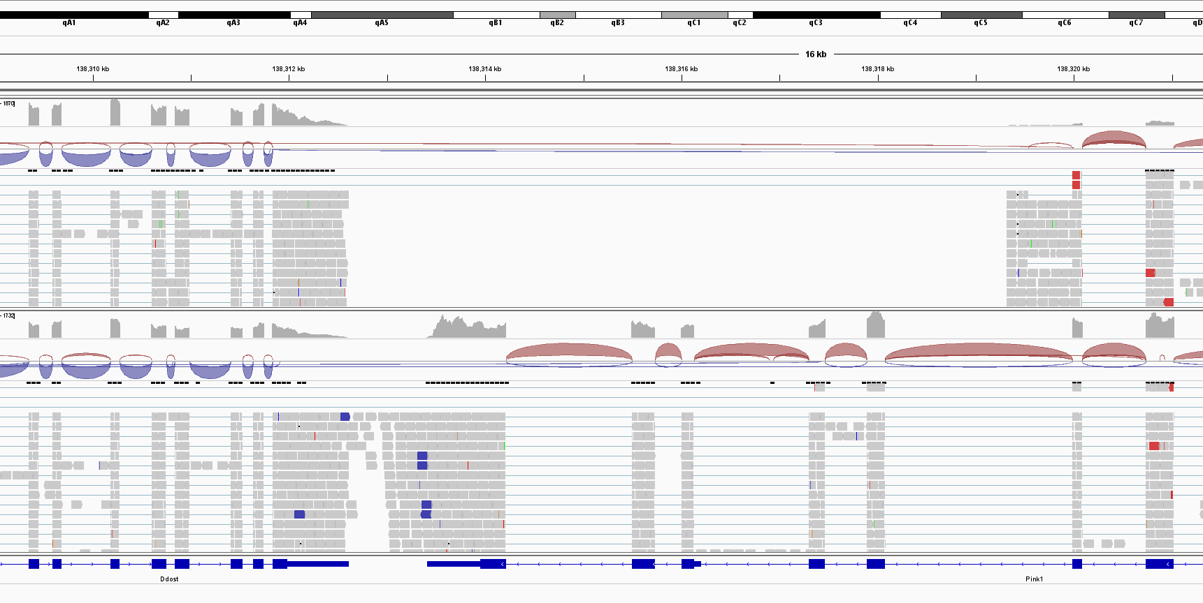
Alignment – IGV
deletion

Slide 18
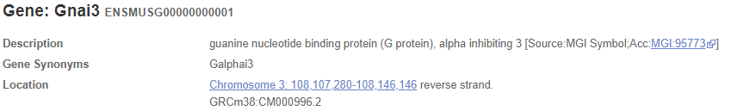
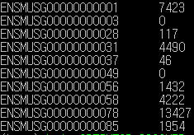
Expression call – HTseq
Read count -> TPM/FPKM

Slide 19
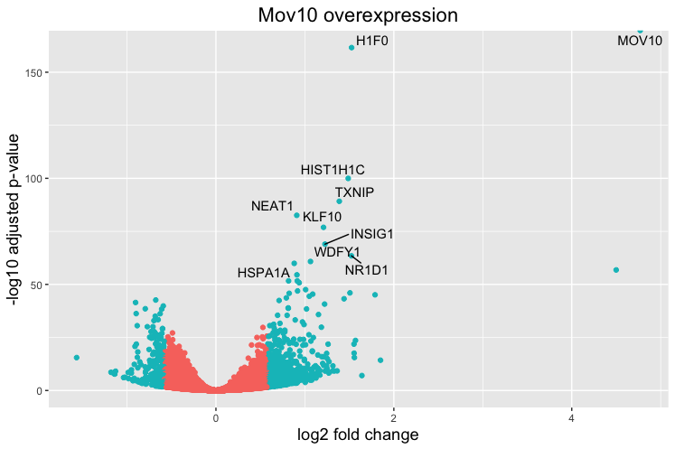
From now on…..
DEG plot example
DEG
(Differentillay expressed gene)
Pathway
(Gene ontology)
DEseq
Plotting - ggplot (Volcano, Heatmap…etc)

Slide 20
Mouse thyroid tissue
Gene Expression analysis
9/25 Fri.

Slide 21
Analysis pipeline
QC
Alignment
Expression call
DEG
(Differentillay expressed gene)
Pathway
(Gene ontology)
FastQC
Trimmomatic
SortmeRNA
STAR
RseqC
HTseq
DEseq2
DAVID, GSEA

Slide 22
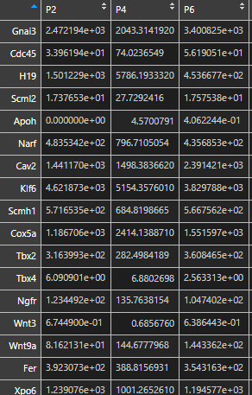
Differently expressed gene – DESeq2
1. Read counts normalization, gene name

Slide 23
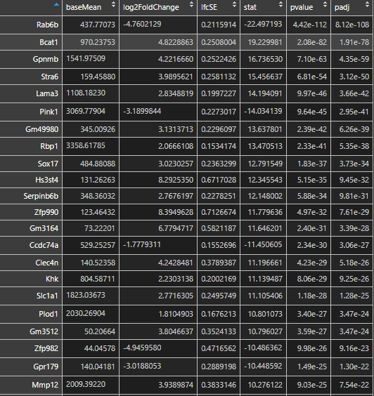
Differently expressed gene – DESeq2
2. DESeq2
Matrix plotting
PCA (Principal Component Analysis)
Sample to sample distance

Slide 24
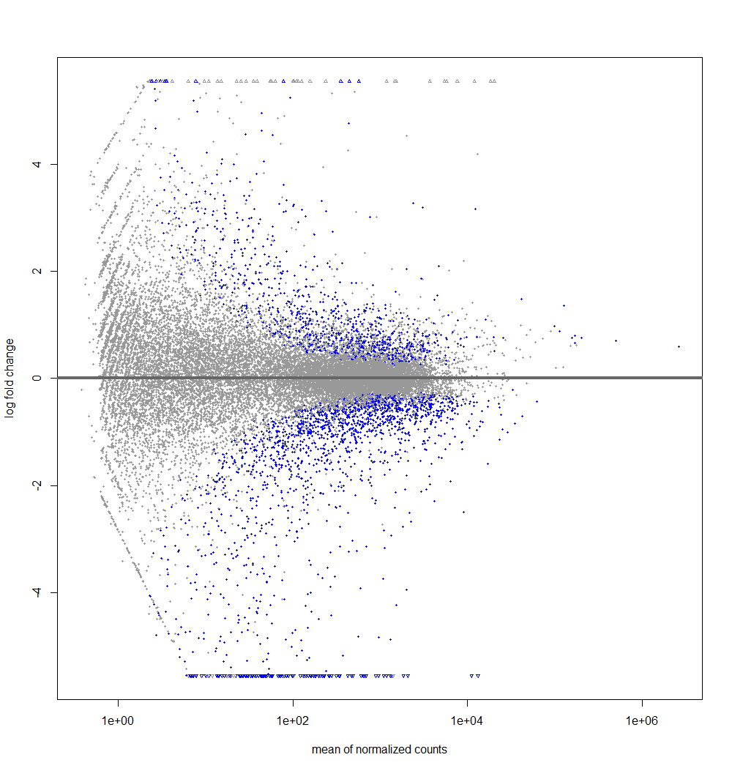
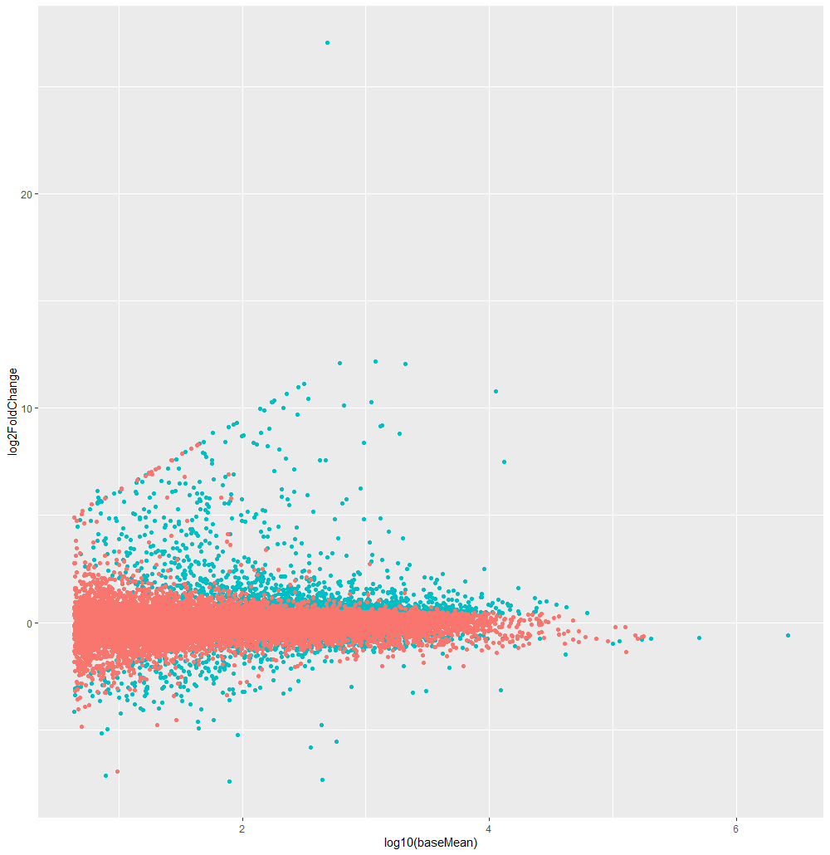
Differently expressed gene – DESeq2
PlotMA
PlotMA
(adjusted p-value < 0.05)

Slide 25
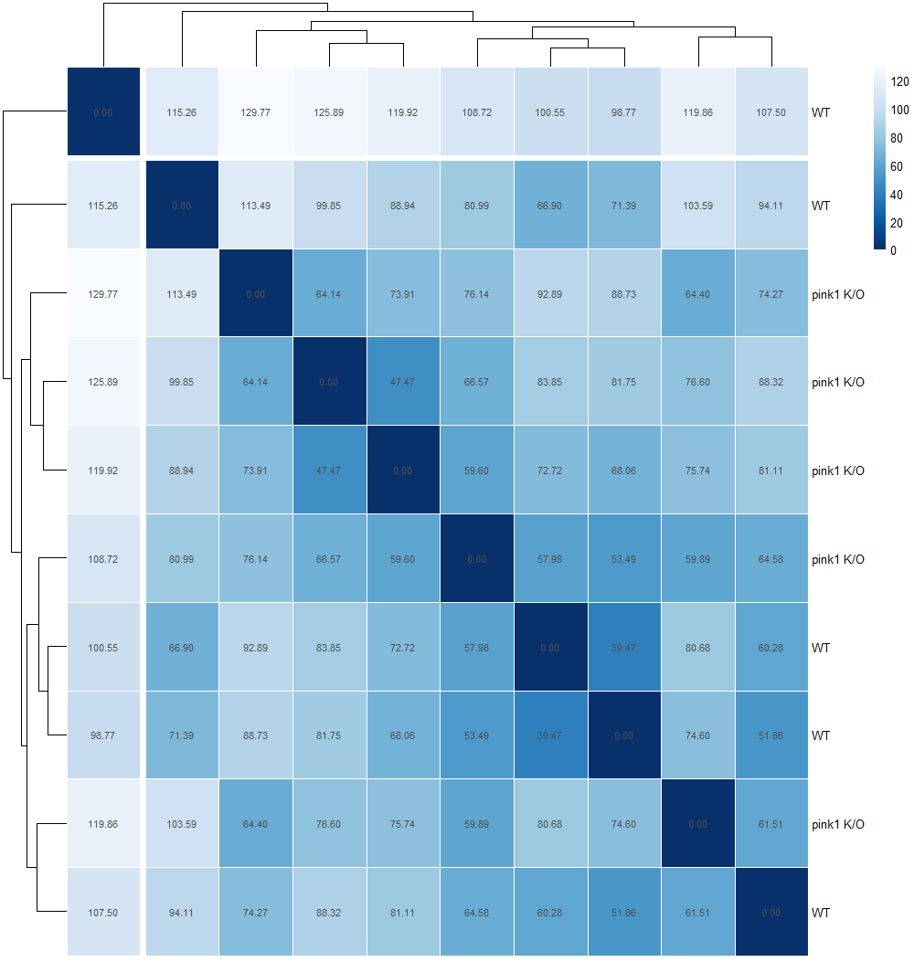
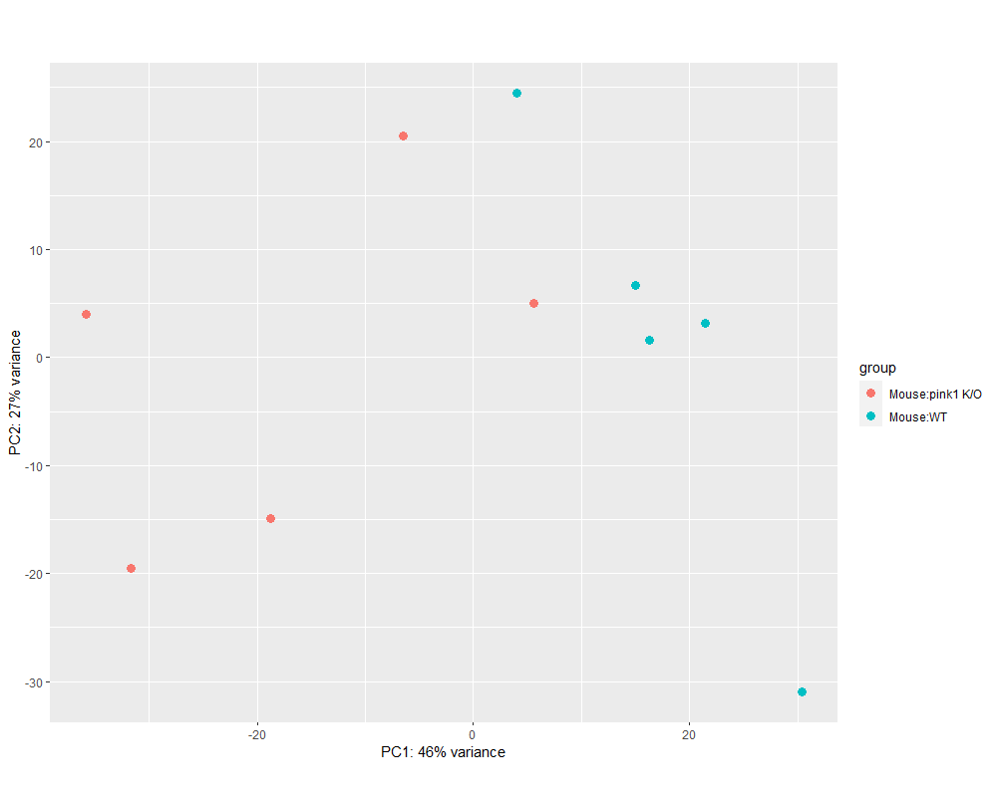
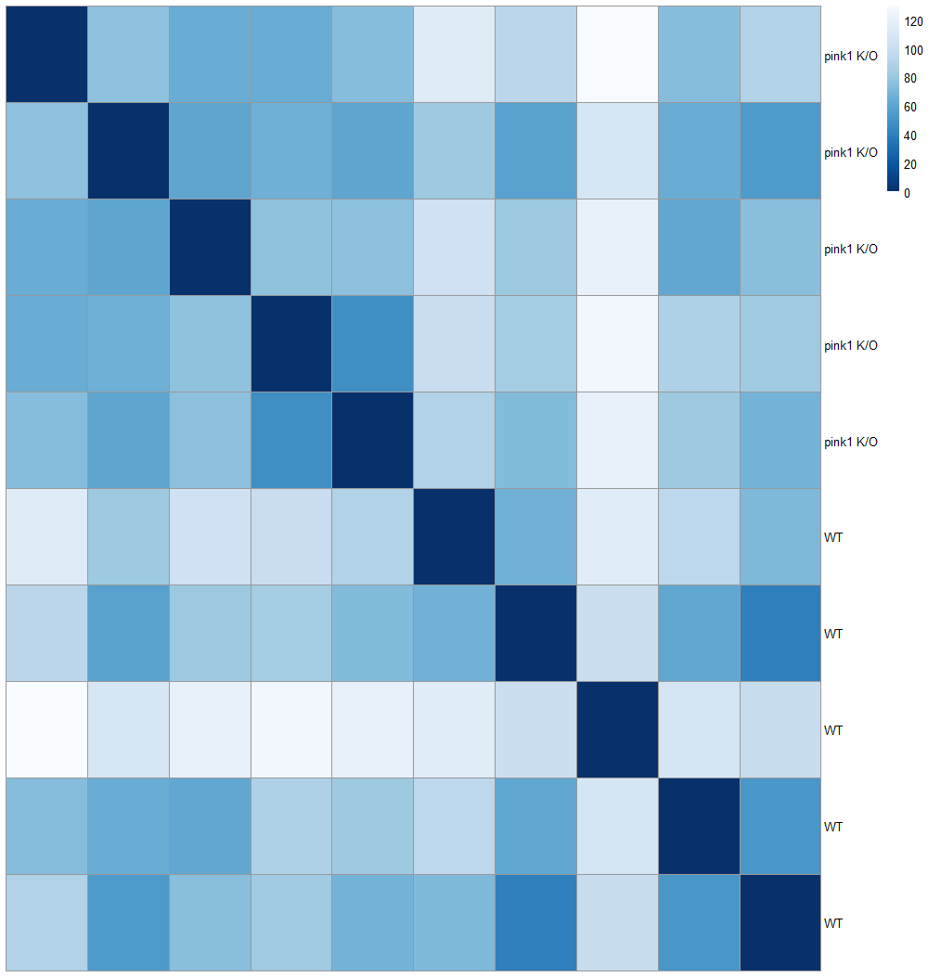
Differently expressed gene – DESeq2
Sample to sample distance
PCA

Slide 26
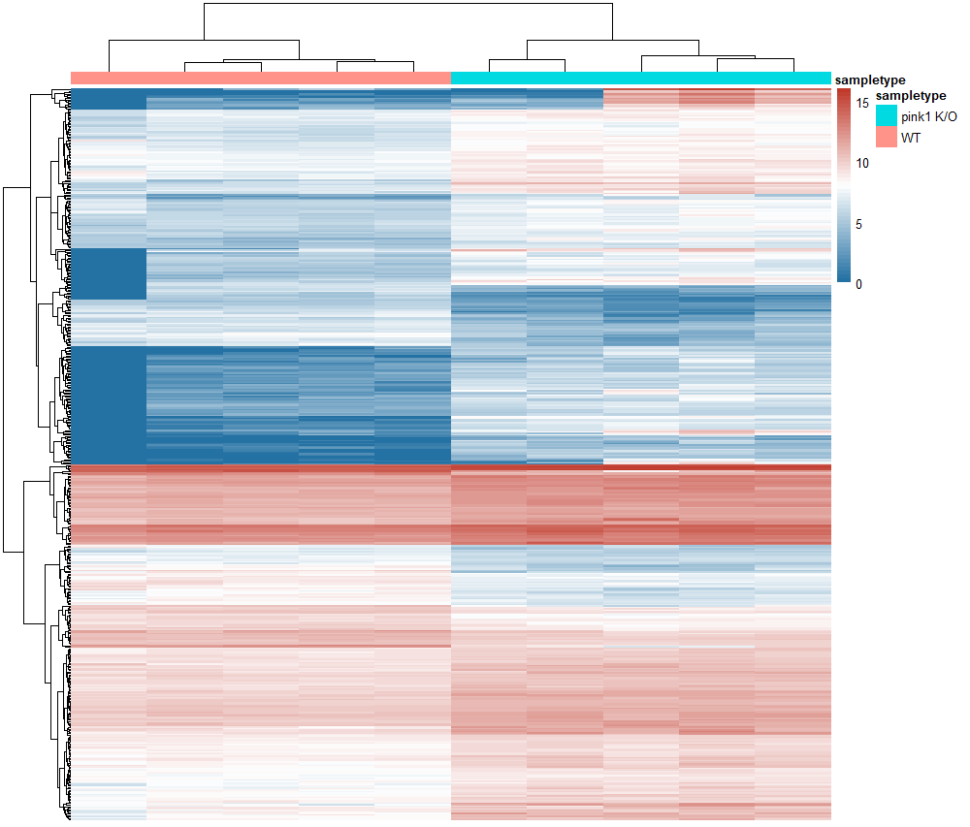
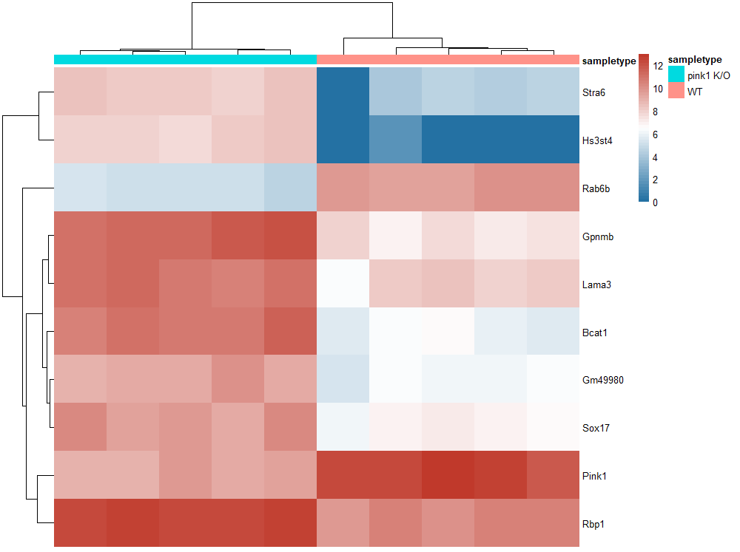
Differently expressed gene – DESeq2
Heatmap Top500 DE genes
Heatmap Top10 DE genes

Slide 27
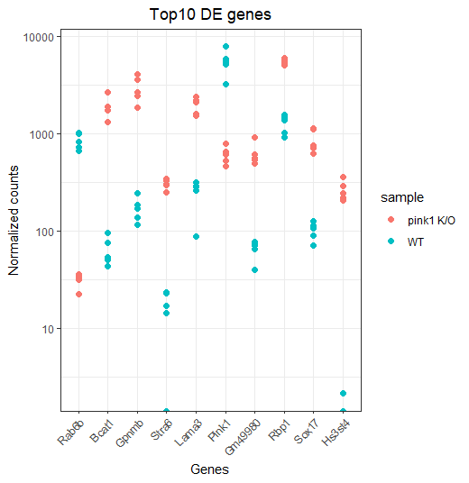
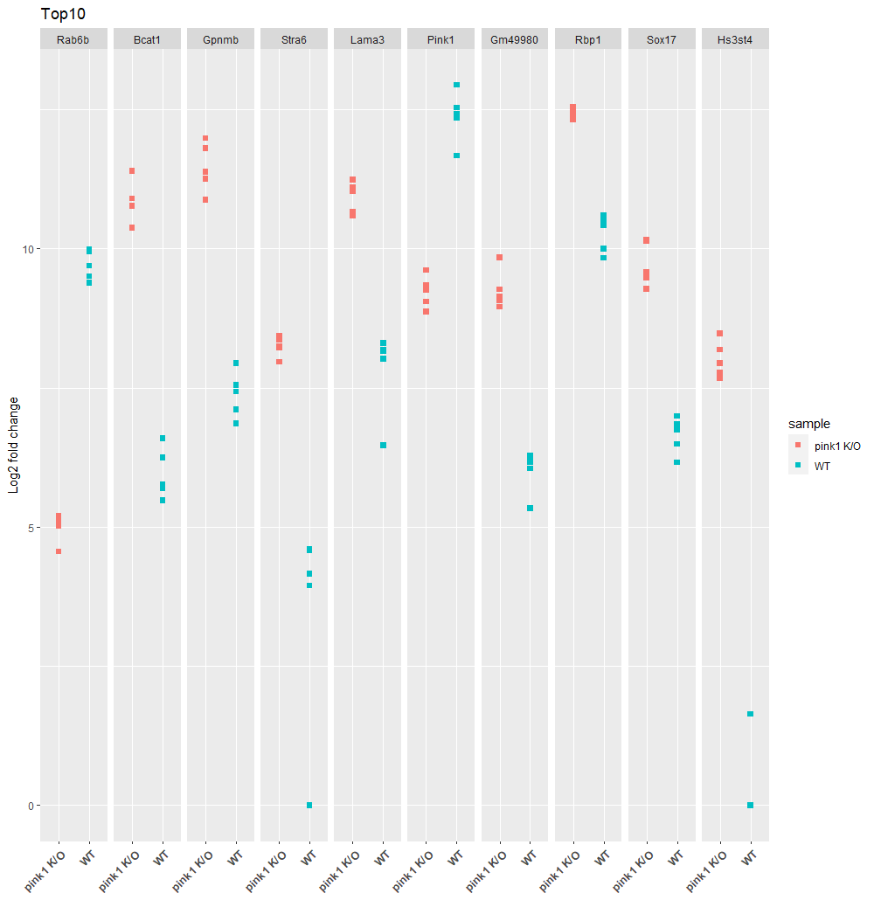
Differently expressed gene – DESeq2
Top10 DE genes (facet grid)

Slide 28
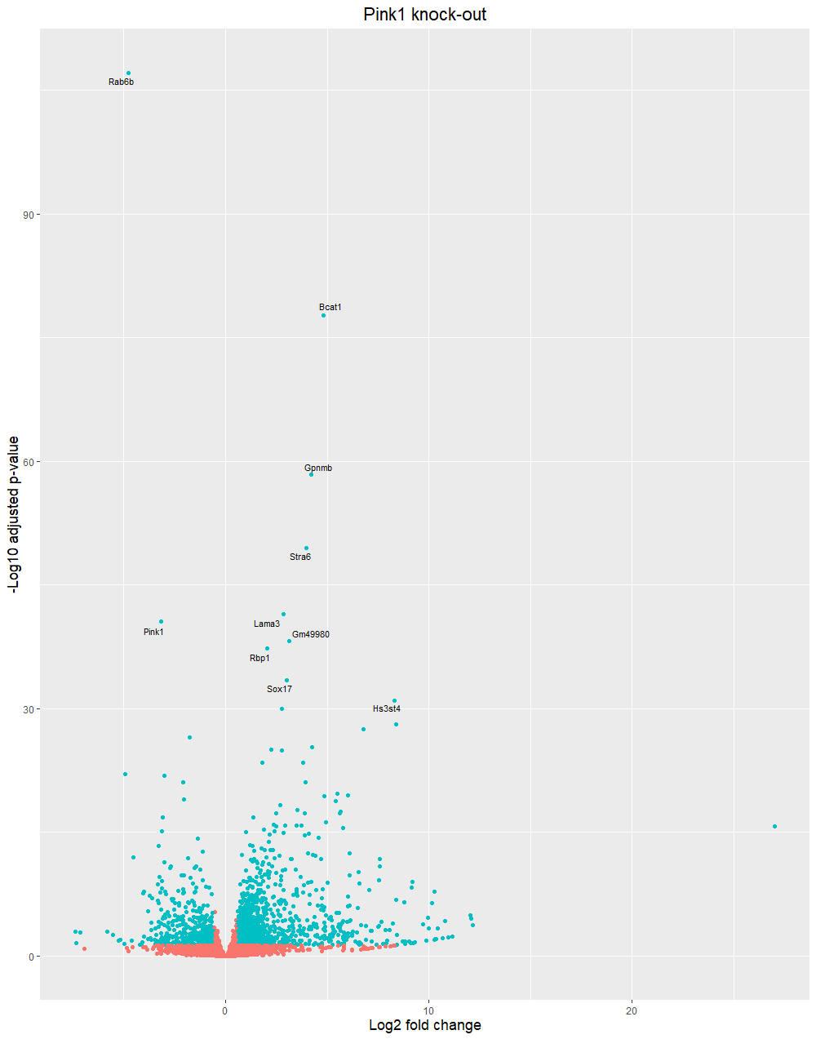
Differently expressed gene – DESeq2
Volcano
P-value | Mouse | Human
8.12E-108 | Rab6b | RAB6B
1.91E-78 | Bcat1 | BCAT1
4.35E-59 | Gpnmb | GPNMB
3.12E-50 | Stra6 | STRA6
3.66E-42 | Lama3 | LAMA3
2.95E-41 | Pink1 | PINK1
6.26E-39 | Gm49980 | ?
5.35E-38 | Rbp1 | RBP1
3.73E-34 | Sox17 | SOX17
9.45E-32 | Hs3st4 | HS3ST4
Linc RNA

Slide 29
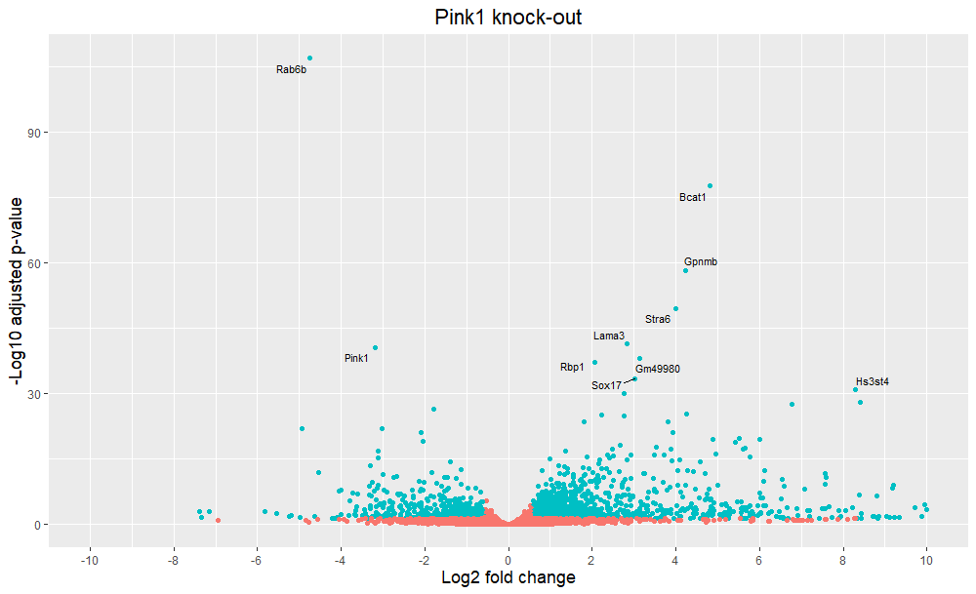

Slide 30
Differently expressed gene – DESeq2
P-value | Mouse | Human | Protein | Location
8.12E-108 | Rab6b | RAB6B | Ras-related protein Rab-6B (GTPase) | Golgi apparatus
1.91E-78 | Bcat1 | BCAT1 | Branched Chain Amino Acid Transaminase 1 | Cytoplasm
4.35E-59 | Gpnmb | GPNMB | Glycoprotein Nonmetastatic Melanoma Protein B | Plasma membrane (cell mem, endosome)
3.12E-50 | Stra6 | STRA6 | Receptor for retinol uptake STRA6 | Plasma membrane
3.66E-42 | Lama3 | LAMA3 | laminin subunit alpha 3 | Extracellular region or secreted
2.95E-41 | Pink1 | PINK1 | PTEN-induced kinase 1 | Cytosol, mitochondrion
6.26E-39 | Gm49980 | ? | (predicted gene) ? | ?
5.35E-38 | Rbp1 | RBP1 | Retinol-binding protein 1 | Cytoplasm (?)
3.73E-34 | Sox17 | SOX17 | Transcription factor SOX-17 | Nucleus
9.45E-32 | Hs3st4 | HS3ST4 | Heparan sulfate glucosamine 3-O-sulfotransferase 4 | Golgi apparatus

Slide 31
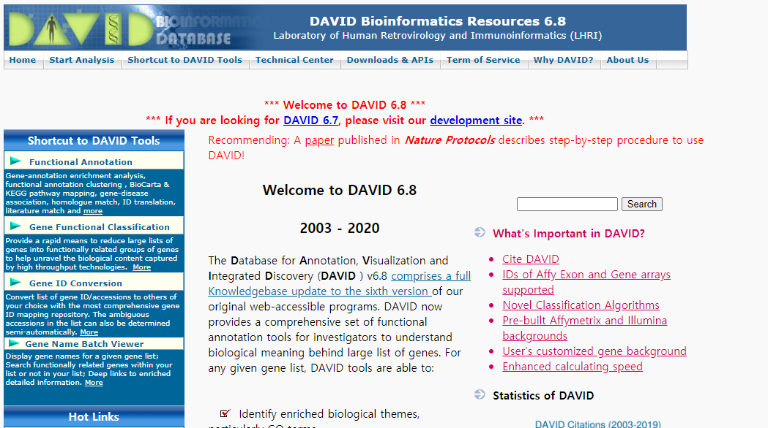
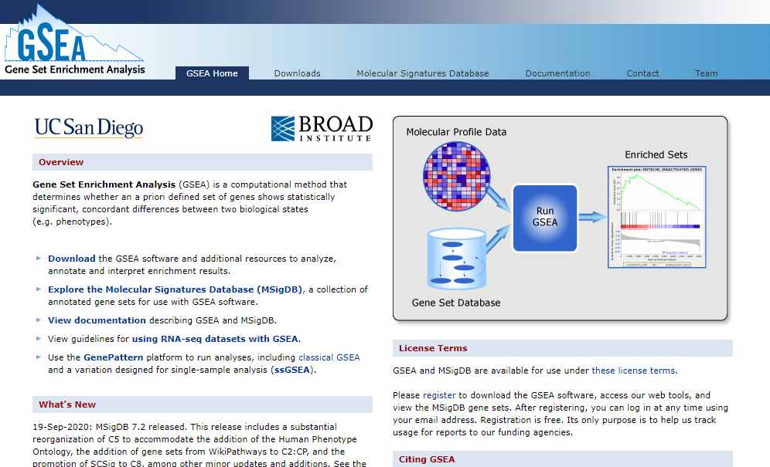
Gene ontology, pathway study – DAVID, GSEA
We got ...
791 UP regulated DE genes
371 DOWN regulated DE genes

Slide 32
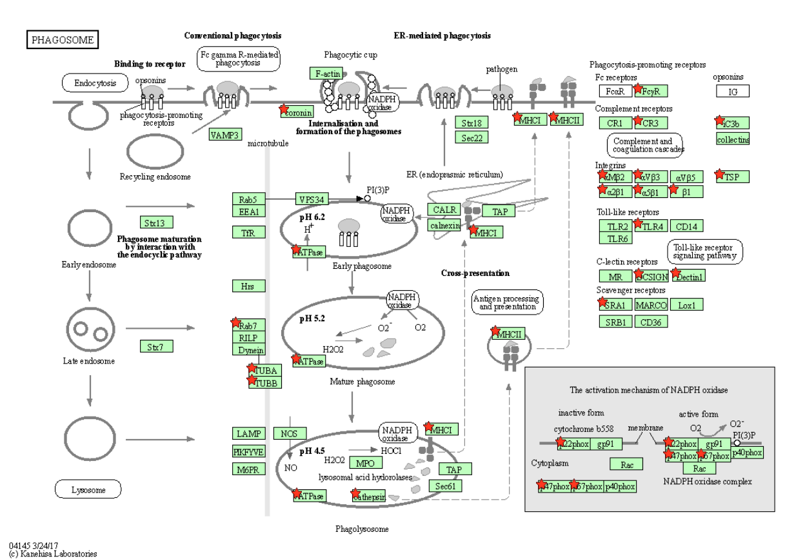
UP regulated pathway

Slide 33
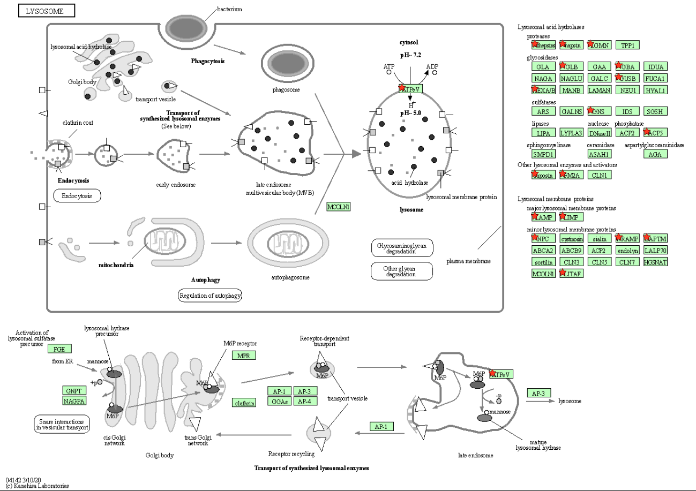
UP regulated pathway

Slide 34
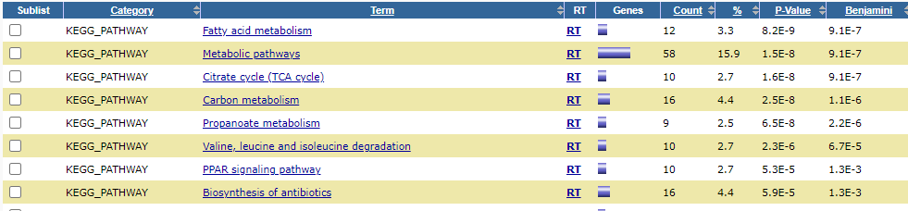
DOWN regulated pathway
All metabolic pathway

Slide 35
PINK1 – PTEN induced putative kinase 1
?
1. healthy
2. Damaged

Slide 36
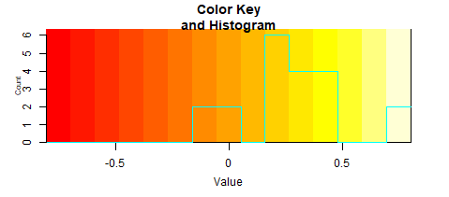
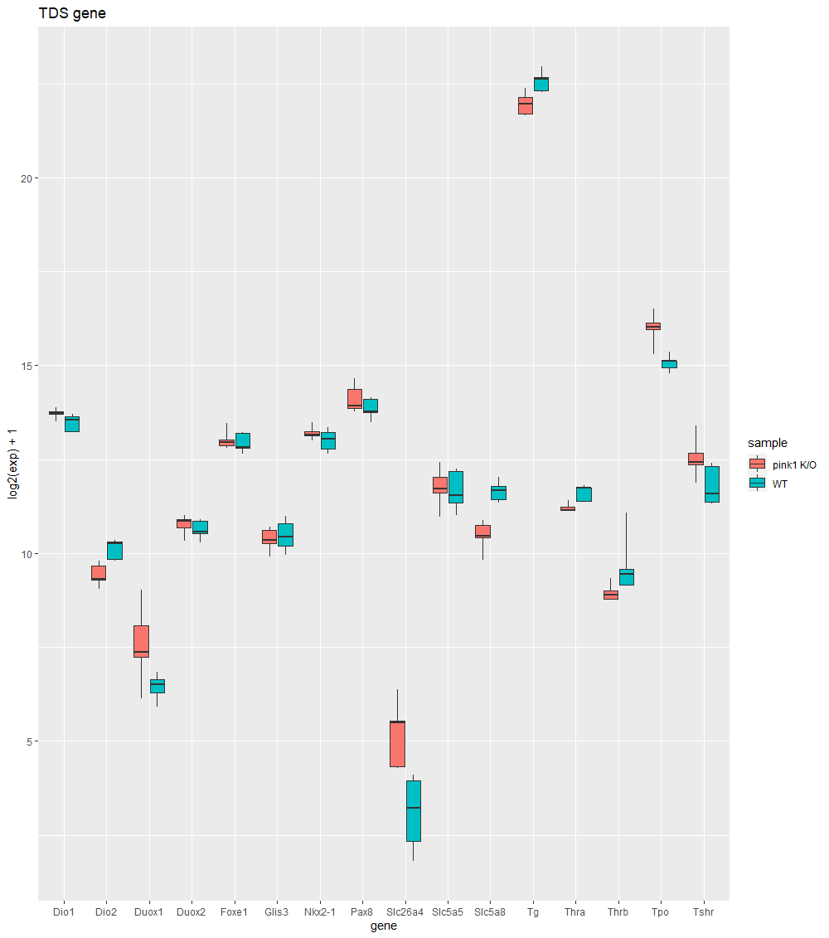
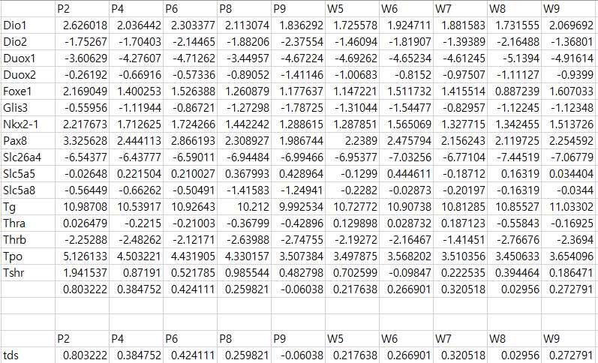
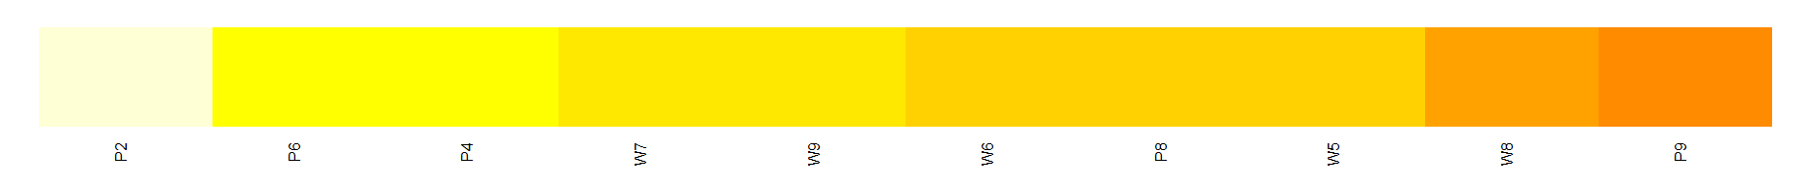
TDS analysis
 | TDS(mean)
Pink1 K/O | 0.362305
WT | 0.221482
 | P2 | P4 | P6 | P8 | P9 | W5 | W6 | W7 | W8 | W9
TDS | 0.803222 | 0.384752 | 0.424111 | 0.259821 | -0.06038 | 0.217638 | 0.266901 | 0.320518 | 0.02956 | 0.272791

Slide 37
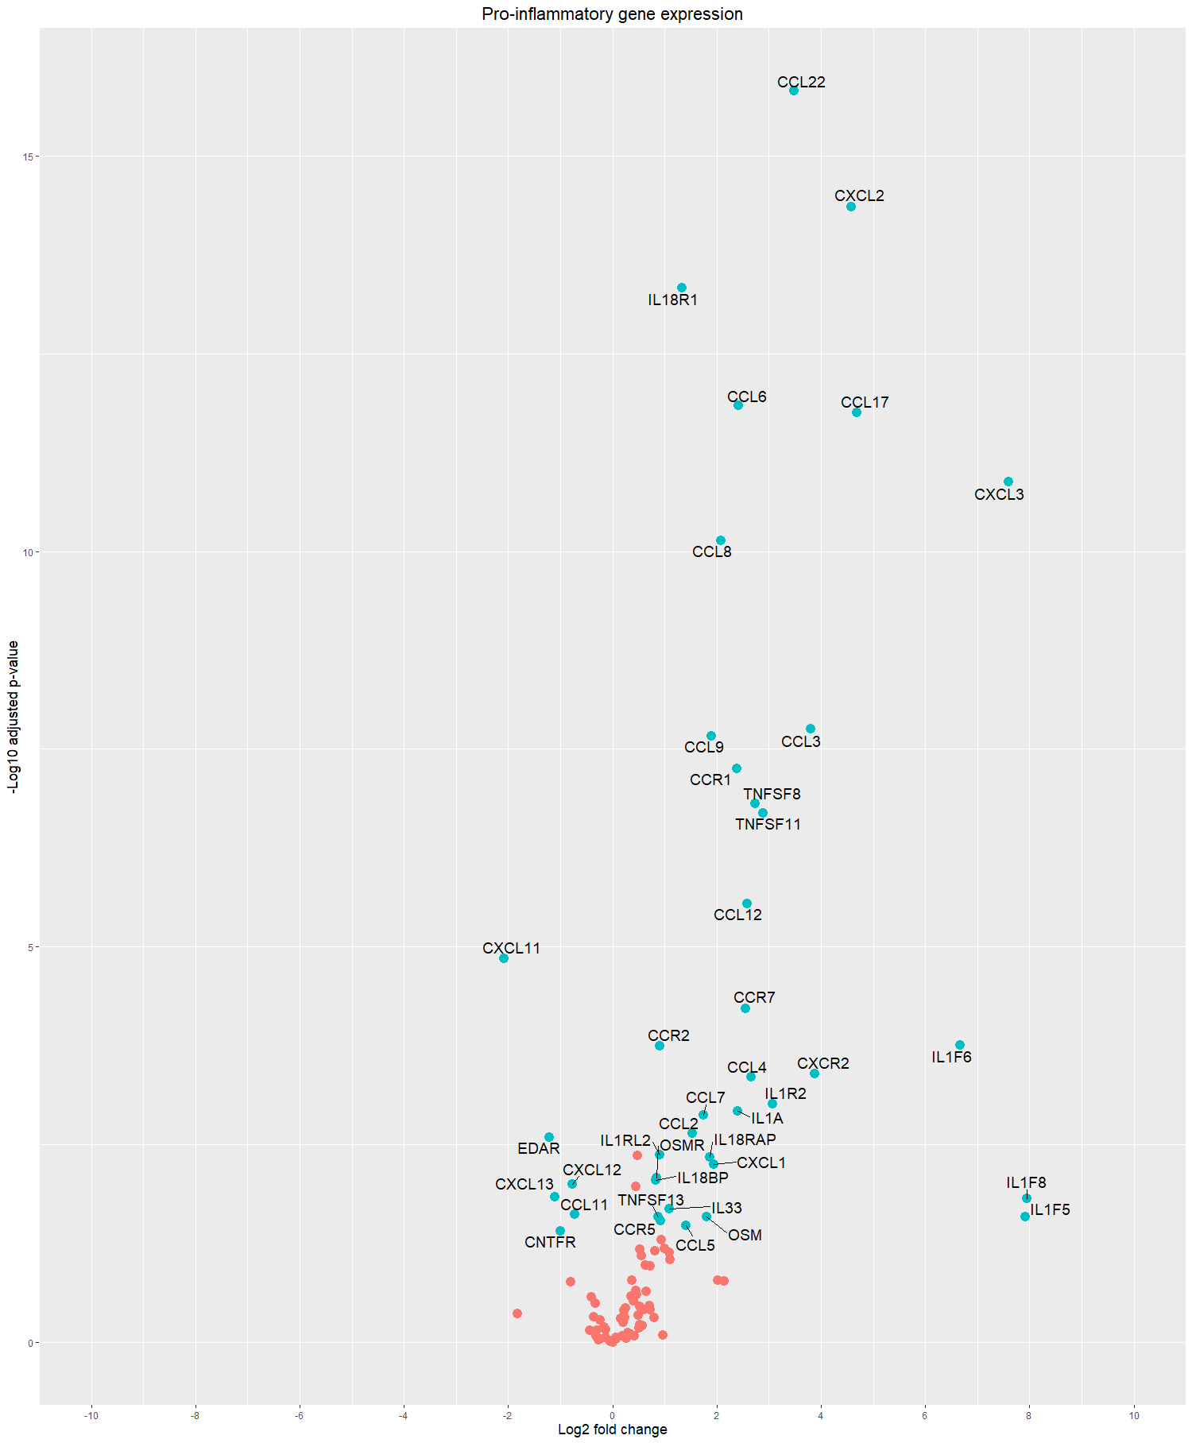
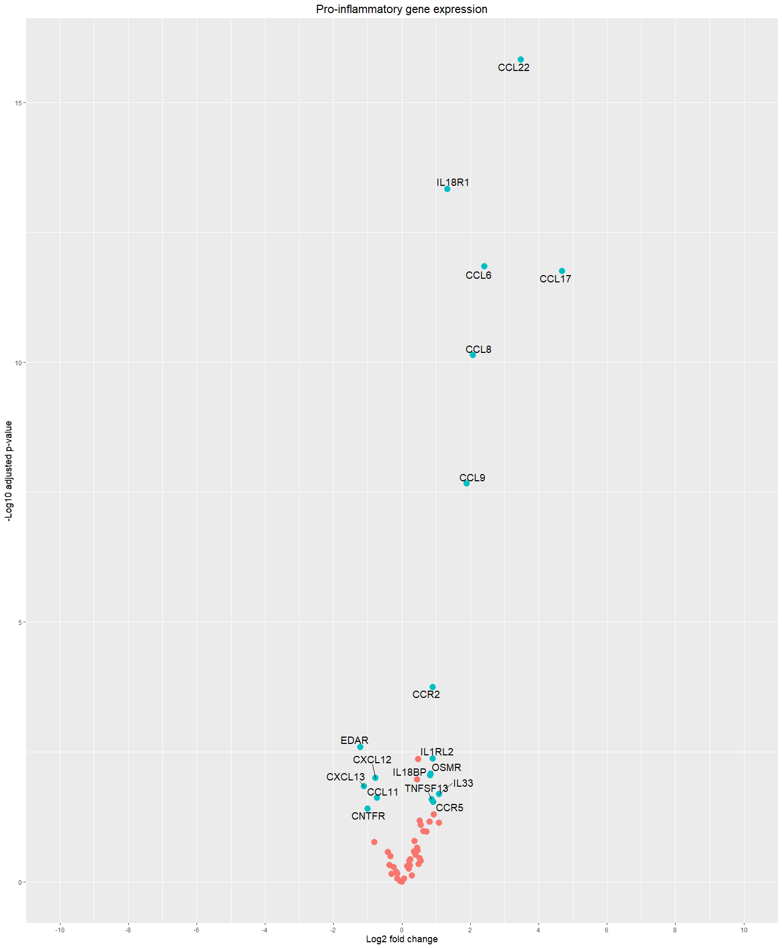
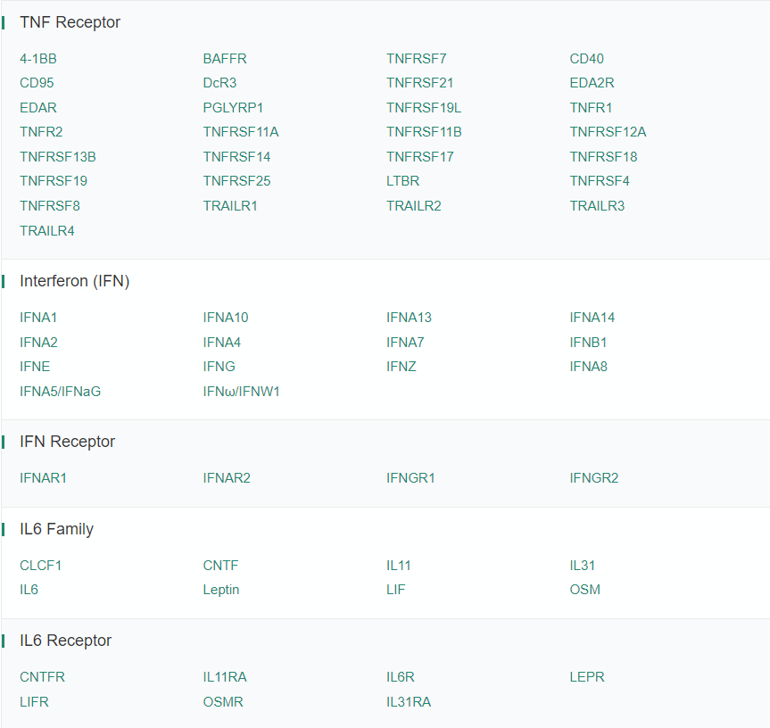



Pro-inflammatory gene
Adj p-value < 0.05
Log fold change > 0.58
baseMean >= 100

Slide 38




Slide 39


ROS And Oxidative Stress In Cell Signaling Transduction Related Products
Oxidative stress
Mitochondrial fusion
Mitophage
via Pink1 K/O
https://www.frontiersin.org/files/Articles/427526/fendo-10-00690-HTML

Slide 40



UP regulated gene ontology

Slide 41

DOWN regulated gene ontology

Slide 42

UP pathway (adj p-value < 0.05)

Slide 43

ENSMUSG00000059498
ENSMUSG00000026656
ENSMUSG00000036896
ENSMUSG00000036887
ENSMUSG00000036905
ENSMUSG00000024371
ENSMUSG00000024164
ENSMUSG00000040552
ENSMUSG00000073418
ENSMUSG00000049130
ENSMUSG00000026365
ENSMUSG00000069441
ENSMUSG00000061928
ENSMUSG00000073421
ENSMUSG00000060586
ENSMUSG00000079547
ENSMUSG00000030830
ENSMUSG00000030786
ENSMUSG00000000290
ENSMUSG00000048163

Slide 44

ENSMUSG00000025351
ENSMUSG00000018774
ENSMUSG00000000594
ENSMUSG00000022500
ENSMUSG00000024413
ENSMUSG00000021242
ENSMUSG00000001750
ENSMUSG00000001348
ENSMUSG00000017760
ENSMUSG00000021939
ENSMUSG00000007891
ENSMUSG00000032359
ENSMUSG00000028111
ENSMUSG00000021477
ENSMUSG00000038642
ENSMUSG00000045594
ENSMUSG00000034707
ENSMUSG00000028048
ENSMUSG00000025534
ENSMUSG00000025232
ENSMUSG00000021190
ENSMUSG00000028581
ENSMUSG00000002204
ENSMUSG00000004207
ENSMUSG00000026177

Slide 45

ID
ENSMUSG00000079293
ENSMUSG00000059498
ENSMUSG00000026656
ENSMUSG00000052688
ENSMUSG00000001750
ENSMUSG00000021477
ENSMUSG00000038642
ENSMUSG00000024164
ENSMUSG00000030707
ENSMUSG00000006519
ENSMUSG00000073411
ENSMUSG00000061232
ENSMUSG00000060550
ENSMUSG00000067212
ENSMUSG00000073421
ENSMUSG00000060586
ENSMUSG00000079547
ENSMUSG00000030786
ENSMUSG00000000290
ENSMUSG00000020689
ENSMUSG00000025044
ENSMUSG00000015950
ENSMUSG00000026480
ENSMUSG00000040152
ENSMUSG00000028047
ENSMUSG00000039005
ENSMUSG00000043091
ENSMUSG00000058672
ENSMUSG00000045136
ENSMUSG00000001525
ENSMUSG00000001473

Slide 46

ID
ENSMUSG00000003873
ENSMUSG00000079293
ENSMUSG00000058715
ENSMUSG00000059498
ENSMUSG00000026656
ENSMUSG00000032688
ENSMUSG00000027646
ENSMUSG00000001750
ENSMUSG00000019979
ENSMUSG00000033765
ENSMUSG00000026928
ENSMUSG00000007891
ENSMUSG00000038642
ENSMUSG00000024164
ENSMUSG00000030707
ENSMUSG00000006724
ENSMUSG00000073421
ENSMUSG00000060586
ENSMUSG00000079547
ENSMUSG00000030786
ENSMUSG00000030789
ENSMUSG00000000290
ENSMUSG00000016024
ENSMUSG00000004864
ENSMUSG00000061878
ENSMUSG00000021457
ENSMUSG00000039005

Slide 47

ID
ENSMUSG00000059498
ENSMUSG00000026656
ENSMUSG00000030579
ENSMUSG00000001348
ENSMUSG00000028111
ENSMUSG00000014599
ENSMUSG00000006519
ENSMUSG00000015340
ENSMUSG00000008136
ENSMUSG00000020689
ENSMUSG00000002699
ENSMUSG00000004864
ENSMUSG00000015950
ENSMUSG00000026480
ENSMUSG00000058818
ENSMUSG00000032462
ENSMUSG00000020901
ENSMUSG00000037902
ENSMUSG00000002111
ENSMUSG00000021457
ENSMUSG00000053113
ENSMUSG00000023992

Slide 48

ID
ENSMUSG00000035914
ENSMUSG00000022636
ENSMUSG00000022512
ENSMUSG00000070473
ENSMUSG00000073411
ENSMUSG00000061232
ENSMUSG00000060550
ENSMUSG00000067212
ENSMUSG00000073421
ENSMUSG00000060586
ENSMUSG00000079547
ENSMUSG00000000732
ENSMUSG00000027009
ENSMUSG00000030830
ENSMUSG00000030786
ENSMUSG00000000290
ENSMUSG00000025321
ENSMUSG00000032012
ENSMUSG00000022656
ENSMUSG00000021638
ENSMUSG00000026395
ENSMUSG00000048163
ENSMUSG00000020592
ENSMUSG00000017009

Slide 49

ID
ENSMUSG00000015143
ENSMUSG00000022512
ENSMUSG00000070473
ENSMUSG00000006519
ENSMUSG00000027009
ENSMUSG00000030830
ENSMUSG00000030786
ENSMUSG00000000290
ENSMUSG00000004864
ENSMUSG00000031207
ENSMUSG00000015950
ENSMUSG00000026480
ENSMUSG00000021638
ENSMUSG00000032462
ENSMUSG00000020901
ENSMUSG00000032011
ENSMUSG00000034116
ENSMUSG00000021823

Slide 50

ID
ENSMUSG00000059498
ENSMUSG00000024164
ENSMUSG00000006519
ENSMUSG00000073421
ENSMUSG00000060586
ENSMUSG00000079547
ENSMUSG00000027009
ENSMUSG00000030786
ENSMUSG00000000290
ENSMUSG00000004864
ENSMUSG00000015950
ENSMUSG00000026480
ENSMUSG00000039005

Slide 51

ID
ENSMUSG00000037805
ENSMUSG00000038900
ENSMUSG00000074129
ENSMUSG00000012405
ENSMUSG00000062328
ENSMUSG00000059070
ENSMUSG00000079641
ENSMUSG00000093674
ENSMUSG00000047215
ENSMUSG00000052146
ENSMUSG00000061983
ENSMUSG00000024608
ENSMUSG00000063457
ENSMUSG00000008683
ENSMUSG00000037563
ENSMUSG00000008668
ENSMUSG00000040952
ENSMUSG00000090733
ENSMUSG00000030744
ENSMUSG00000007892

Slide 52

ID
ENSMUSG00000036896
ENSMUSG00000036887
ENSMUSG00000036905
ENSMUSG00000024371
ENSMUSG00000024164
ENSMUSG00000040552
ENSMUSG00000073418
ENSMUSG00000049130
ENSMUSG00000026365
ENSMUSG00000060459
ENSMUSG00000031538
ENSMUSG00000046223
ENSMUSG00000021822
ENSMUSG00000037411

Slide 53

ID
ENSMUSG00000030793
ENSMUSG00000033765
ENSMUSG00000025888
ENSMUSG00000036896
ENSMUSG00000036887
ENSMUSG00000036905
ENSMUSG00000024371
ENSMUSG00000024164
ENSMUSG00000073418
ENSMUSG00000030786
ENSMUSG00000000290
ENSMUSG00000004864
ENSMUSG00000039005

Slide 54

ID
ENSMUSG00000037946
ENSMUSG00000022488
ENSMUSG00000027646
ENSMUSG00000015143
ENSMUSG00000025372
ENSMUSG00000001507
ENSMUSG00000027009
ENSMUSG00000030830
ENSMUSG00000030786
ENSMUSG00000030789
ENSMUSG00000000290
ENSMUSG00000020689
ENSMUSG00000020758
ENSMUSG00000025321
ENSMUSG00000031207
ENSMUSG00000032470
ENSMUSG00000031284
ENSMUSG00000032462
ENSMUSG00000020901
ENSMUSG00000032006
ENSMUSG00000049775
ENSMUSG00000034116
ENSMUSG00000021823

Slide 55

ID
ENSMUSG00000024308
ENSMUSG00000021939
ENSMUSG00000021477
ENSMUSG00000038642
ENSMUSG00000073411
ENSMUSG00000061232
ENSMUSG00000060550
ENSMUSG00000067212
ENSMUSG00000073421
ENSMUSG00000060586
ENSMUSG00000079547
ENSMUSG00000031838
ENSMUSG00000021190

Slide 56

ID
ENSMUSG00000026656
ENSMUSG00000042228
ENSMUSG00000020143
ENSMUSG00000003283
ENSMUSG00000026288
ENSMUSG00000015950
ENSMUSG00000032462
ENSMUSG00000020901
ENSMUSG00000052151
ENSMUSG00000026395
ENSMUSG00000061878
ENSMUSG00000021457
ENSMUSG00000034116

Slide 57

ID
ENSMUSG00000001507
ENSMUSG00000027009
ENSMUSG00000020689
ENSMUSG00000020758
ENSMUSG00000025321
ENSMUSG00000024421
ENSMUSG00000026639
ENSMUSG00000026479
ENSMUSG00000029304
ENSMUSG00000020592
ENSMUSG00000017009
ENSMUSG00000040152
ENSMUSG00000028047

Slide 58

ID
ENSMUSG00000052688
ENSMUSG00000015143
ENSMUSG00000030786
ENSMUSG00000000290
ENSMUSG00000024421
ENSMUSG00000026639
ENSMUSG00000026479
ENSMUSG00000032462
ENSMUSG00000020901
ENSMUSG00000044594
ENSMUSG00000062345
ENSMUSG00000042842
ENSMUSG00000045827
ENSMUSG00000039005
ENSMUSG00000021823

Slide 59


ID
ENSMUSG00000025351
ENSMUSG00000027646
ENSMUSG00000021477
ENSMUSG00000023067
ENSMUSG00000007989
ENSMUSG00000022831
ENSMUSG00000020689
ENSMUSG00000004864
ENSMUSG00000031207
ENSMUSG00000032470
ENSMUSG00000032462
ENSMUSG00000020901
ENSMUSG00000024998
ENSMUSG00000046223
ENSMUSG00000021822
ENSMUSG00000020592
ENSMUSG00000017009
ENSMUSG00000040152
ENSMUSG00000039005
ENSMUSG00000030170
ENSMUSG00000022382

Slide 60

ID
ENSMUSG00000001750
ENSMUSG00000001348
ENSMUSG00000028111
ENSMUSG00000021477
ENSMUSG00000014599
ENSMUSG00000073421
ENSMUSG00000060586
ENSMUSG00000079547
ENSMUSG00000030830
ENSMUSG00000000290
ENSMUSG00000039005
ENSMUSG00000089669

Slide 61

ID
ENSMUSG00000031780
ENSMUSG00000094686
ENSMUSG00000031779
ENSMUSG00000018927
ENSMUSG00000009185
ENSMUSG00000019122
ENSMUSG00000049103
ENSMUSG00000079227
ENSMUSG00000014599
ENSMUSG00000071714
ENSMUSG00000071713
ENSMUSG00000033467
ENSMUSG00000041324
ENSMUSG00000037035
ENSMUSG00000022514
ENSMUSG00000026070
ENSMUSG00000031304
ENSMUSG00000030748
ENSMUSG00000003882
ENSMUSG00000040329
ENSMUSG00000022146
ENSMUSG00000089669
ENSMUSG00000028965

Slide 62

ID
ENSMUSG00000020357
ENSMUSG00000027646
ENSMUSG00000015143
ENSMUSG00000001507
ENSMUSG00000027009
ENSMUSG00000020689
ENSMUSG00000020758
ENSMUSG00000025321
ENSMUSG00000024421
ENSMUSG00000026639
ENSMUSG00000026479
ENSMUSG00000031284
ENSMUSG00000032462
ENSMUSG00000020901
ENSMUSG00000032006
ENSMUSG00000029304
ENSMUSG00000040152
ENSMUSG00000028047
ENSMUSG00000034116
ENSMUSG00000021823

Slide 63

Down pathway (adj p-value < 0.05)

Slide 64


GSEA
Cell cycle arrest
Apoptosis
Inflammatory response
Immune response

Slide 65
Expected pathway
Metabolic pathway
via mitochondria dysfunction
Immune cell
ATP decrease
ROS stress
Immune cell
cytokine
cytokine
Necroptosis (?)
Apoptosis(?)
APOPTOSIS
inflammatory
cytokine

Slide 66

Pathway analysis
UP & DOWN
Metabolic pathway
Cell cycle arrest
Necroptosis (?)
Apoptosis(?)
Immune response
Inflammation
via mitochondria dysfunction
OXIDATIVE PHOSPHORYLATION
FATTY ACID METABOLISM
METABOLIC PATHWAY
TCA CYCLE
CARBON CYCLE
HYPOXIA
E2F_TARGETS
G2M_CHECKPOINT
P53_PATHWAY
KRAS_SIGNALING
MYC_TARGETS
MITOTIC_SPINDLE
APOPTOSIS
COMPLEMENT
COAGULATION
APICAL_JUNCTION
CELL_ADHESION
INTERFERON_ALPHA_RESPONSE
INTERFERON_GAMMA_RESPONSE
INFECTION DEFENSE PATHWAY
LYSOSOME
PHAGOSOME ANTIGEN PROCESSING
CYTOKINE-CYTOKINE RECEPTOR INTERACTION
FOCAL ADHENSION
INFLAMMATORY_RESPONSE
IL2_STAT5_SIGNALING
IL6_JAK_STAT3_SIGNALING
TNFA_SIGNALING_VIA_NFKB

Slide 67


PINK1 expression in lymphocytic thyroiditis
Normal tissue comparison
T-test, p-value : 7.02e-5

Slide 68



PINK1 expression in lymphocytic thyroiditis
Cancer(all) tissue comparison
T-test, p-value : 3.99e-5

Slide 69


PINK1 expression in lymphocytic thyroiditis
Cancer(FA/miFTC) tissue comparison
T-test, p-value : 0.448

Slide 70


PINK1 expression in lymphocytic thyroiditis
Cancer(FA only) tissue comparison
T-test, p-value : 0.821

Slide 71


PINK1 expression in lymphocytic thyroiditis
Cancer(miFTC only) tissue comparison
T-test, p-value : 0.821

Slide 72


PINK1 expression in lymphocytic thyroiditis
Cancer(FVPTC) tissue comparison
T-test, p-value : 0.00621

Slide 73


PINK1 expression in lymphocytic thyroiditis
Cancer(PTC) tissue comparison
T-test, p-value : 0.0898

Slide 74

PINK1 expression in lymphocytic thyroiditis
Summary
Type | LT | no-LT | p-value | Adj p-value
Normal | 24 | 57 | 7.02e-05 | 0.000351
FA | 4 | 21 | 8.21e-01 | 0.821
miFTC | 7 | 23 | 1.29e-01 | 0.2694
FVPTC | 16 | 33 | 6.21e-03 | 0.02484
PTC | 37 | 39 | 8.98e-02 | 0.2694

Slide 75

PINK1 expression in lymphocytic thyroiditis
Summary
Type | # | p-value | Adj p-value
FA | 25 | 4.30e-04 | 0.00086
miFTC | 30 | 7.86e-05 | 0.000236
FVPTC | 49 | 4.72e-01 | 0.472
PTC | 76 | 4.85e-05 | 0.000194
# Normal : 81

Slide 76

PINK1 expression in lymphocytic thyroiditis
Summary
Type | # | p-value | Adj p-value
Normal | 81 | 1.16e-01 | 2.32e-01
FA | 25 | 1.00e-03 | 4.00e-03
miFTC | 30 | 74.35e-04 | 2.00e-03
FVPTC | 49 | 6.94e-01 | 6.94e-01
PTC | 76 | 1.86e-09 | 9.30e-09
# Total : 261

